Slide 1


الدراسات العليا (تمهيدي ماجستير)
مناقشات في التخصص باللغة الاجنبية
المحاضرة الثالثة
قسم المنتجات المعدنية والحلي
أ.م.د/محمد العوامي محمد

Slide 2
JEWELRY MAKING
Precious Metal Guide(Raw materials)
This Metal Education describes the characteristics of three Precious metals which are extensively used in jewelry manufacturing along with tips for their care.
By understanding these characteristics, you'll be able to shop with confidence.
Asst.Prof :Mohamed el Awamy Mohamed (2020) Foreign language discussions (3)

Slide 3
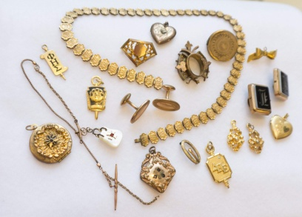
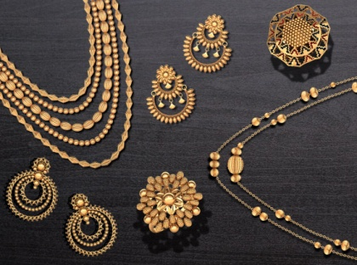
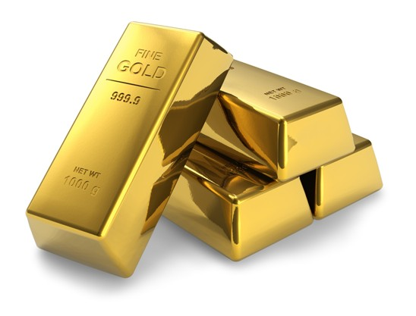
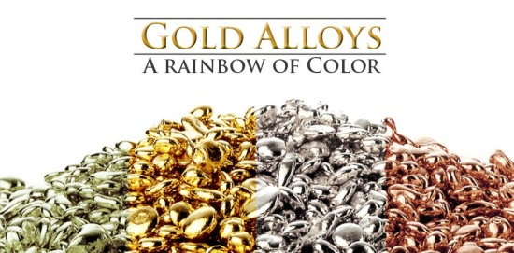
Gold
Gold is an extraordinary and rare precious metal, with an unmatched combination of chemical and physical properties.
It is the only yellow metal and the name gold derives from the Old English word for yellow, 'Geolu'.
Gold is the most non-reactive of all metals and it does not oxidize under ordinary conditions, meaning that it will never rust and never tarnish.
Asst.Prof :Mohamed el Awamy Mohamed (2020) Foreign language discussions (3)

Slide 4
Gold's physical properties of high electrical conductivity and chemical inertness make it an excellent and reliable conductor, particularly in harsh environments, where temperatures can range from -55°C to 200°C.
No other metal is as malleable as gold. A single ounce of the metal can be drawn into a wire five miles long. Gold is also an excellent conductor of thermal energy. Due to all these specialties, gold is used in various other industrial applications along with jewelry manufacturing.
Asst.Prof :Mohamed el Awamy Mohamed (2020) Foreign language discussions (3)

Slide 5
Gold is widely dispersed through the Earth's crust and is found in two types of deposits:
Lode Deposits
These are found in solid rock form and are mined by using conventional mining techniques.
Placer Deposits
These are gravelly deposits found in stream beds and are the products of eroding lode deposits. Since gold is found uncombined in nature, early goldsmiths would collect small nuggets of gold from stream beds etc., and then weld them together by hammering.
Asst.Prof :Mohamed el Awamy Mohamed (2020) Foreign language discussions (3)

Slide 6
Gold Purity
Gold's purity is measured in karats. The term ‘Karat’ is different from the term ‘Carat’, which is used to measure weight in gemstones. The purity of gold in karat determines its value. The term ‘Karat’ is derived from ancient bazaars where ‘Carob’ beans were used to weigh precious metals.
Asst.Prof :Mohamed el Awamy Mohamed (2020) Foreign language discussions (3)

Slide 7
Pure gold is very soft and pliable, and alloys of different precious metals are combined with pure gold to enhance its durability and strength, as well as creating a blush in the gold’s appearance with different color tones.
24 karat is 100 % pure gold, and is more expensive and less durable than gold that is alloyed with other metals.
Asst.Prof :Mohamed el Awamy Mohamed (2020) Foreign language discussions (3)

Slide 8
Gold purity for the mostly used Karats:
-24 Karat - 24K Gold with 100% purity
-22 Karat - 22K Gold with 91.6% purity
-18 Karat - 18K Gold with 75% purity
-14 Karat - 14K Gold with 58.33% purity
-12 Karat - 12K Gold with 50% purity
-10 Karat - 10K Gold with 41.67% purity
24 karat gold is soft pure gold without any alloys and it has a deep yellow color and a rich luster.
Asst.Prof :Mohamed el Awamy Mohamed (2020) Foreign language discussions (3)

Slide 9
Gold Color
In its pure form, gold has a metallic luster with deep yellow in color, but when mixed or alloyed with other metals, such as silver, copper, zinc, nickel, platinum, palladium, etc. then it creates various color hues like white, pink/ rose, green and the seldom found blue, purple and black.
Asst.Prof :Mohamed el Awamy Mohamed (2020) Foreign language discussions (3)

Slide 10
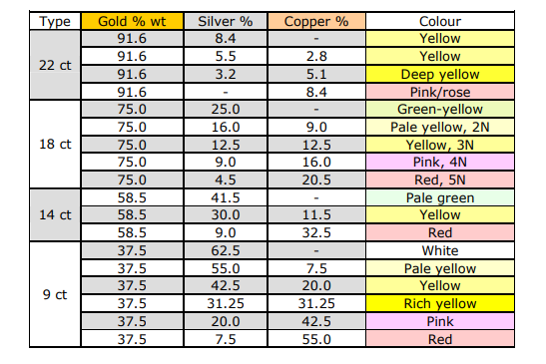
Asst.Prof :Mohamed el Awamy Mohamed (2020) Foreign language discussions (3)

Slide 11
Yellow Gold
Yellow gold is the most frequently seen and a timeless color.
It is usually alloyed with silver and copper. Depending on the karat gold (14K, 18K or 22K), the color of yellow gold may vary from a softer shimmering yellow to a bright rich yellow.
This is due to the varying alloy combinations. The color contrast of yellow gold is most suitable to diamonds and other delicately colored gemstones, as they can appear brilliant and vivid.
Asst.Prof :Mohamed el Awamy Mohamed (2020) Foreign language discussions (3)

Slide 12
White Gold
White gold is harder than yellow gold with a bright lustrous white color.
It is most commonly alloyed with a significant percentage of silver, or a mixture of other white precious metals.
Palladium and nickel are other precious metals which are alloyed to create white gold. Due to the presence of nickel in the white gold alloy, it tends to be harder than yellow gold.
The percentage of gold naturally varies, according to the quantity of additional precious metal, which is included in the formulation of the alloy.
White gold is highly reflective and not subject to tarnish.
Asst.Prof :Mohamed el Awamy Mohamed (2020) Foreign language discussions (3)

Slide 13
Pink / Rose Gold
Pink / Rose gold is alloyed with copper, and at times possibly even with silver. --The proportions are about three parts of 24-karat gold to one part of copper. -These alloys blush and accentuate the gold with a pink hue, which varies in color depending upon the amount of copper blended with the pure gold.
-The quantity of copper determines whether the gold is pink or more rose colored in tone and highlights.
Asst.Prof :Mohamed el Awamy Mohamed (2020) Foreign language discussions (3)

Slide 14
Green Gold
Pure gold is mixed with silver to get green gold. Although this color is not very popular but still it gives wearer an opportunity to look different.
Other Gold Colors
To get the blue or black colors, iron is alloyed with pure gold whereas to get purple color, pure gold is alloyed with specific percentages of aluminum, tin, and thorium. Some examples of alloying formulas to achieve gold color variances are:
18K Yellow Gold: 75% fine gold, 15% copper, 10% fine silver.
14K Yellow Gold: 58.5% fine gold, 29% copper, 12.5% fine silver.
18K White Gold: 75% fine gold, 2 % copper, 17% nickel, 6% zinc.
14K White Gold: 58.5% fine gold, 23% copper, 12.5% nickel, 6% zinc.
18K Green Gold: 75% fine gold, 25% fine silver.
18K Pink/Rose Gold: 75% fine gold, 25% copper.

Slide 15
Gold Pricing
Raw, un-worked gold pricing is based on the karat ratio and the gold weight.
But Gold pricing, in finished jewelry or decorative item, is based on a number of factors, including karatage, gram weight, design and craftsmanship.
The techniques of construction can make a piece more durable and flexible for added comfort and it may increase the gold price for that piece.
Gold jewelry is mainly produced by machine. Any additional hand finishing or textural interest may also raise the cost.

Slide 16
Gold Type
Solid gold is the most frequently seen gold type available in the market but buyers should also be aware of the other gold types available, which deliver comparable beauty at lower value. Naturally, the higher the gold proportions or weight in the other types, the more expensive they are:
1-Gold Filled
It is also known as gold overlay, and refers to a layer of at least 10-karat gold that has been permanently bonded by heat and pressure to one or more surfaces of the support metal, then rolled or drawn to a prescribed thickness. The karat gold must be at least 1/10 of the total weight.

Slide 17
2-Gold Plate
Gold Plate refer, a thin layer of plating of 10-karat gold or better which has been bonded to a base metal. The karat gold content may be less than 1/20, but it must be properly identified by weight in terms of total metal content.
3-Gold Leaf
Gold Leaf refers, ultra thin gold plating which is pounded and applied by hand to an object. Gold has helped in shaping the course of human history.
Due to gold’s scarcity and beauty, this metal has become one of the most important metals in our daily life.

Slide 18
والى لقاء آخر في المحاضرة القادمة ان شاء الله
والسلام عليكم ورحمة الله
مناقشات في التخصص باللغة الاجنبية( 3) (2020) أ.م.د/محمد العوامي محمد

