Slide 1


الدراسات العليا (تمهيدي ماجستير)
مناقشات في التخصص باللغة الاجنبية
المحاضرة الرابعة
قسم المنتجات المعدنية والحلي
أ.م.د/محمد العوامي محمد

Slide 2
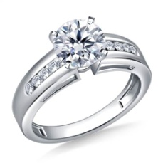
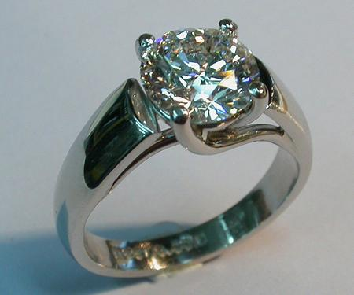
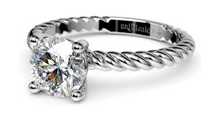
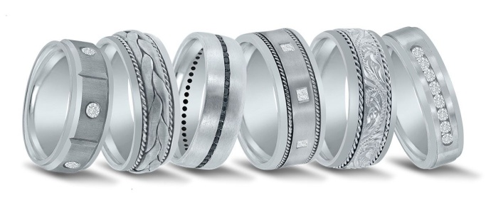
Platinum
Platinum
Platinum Purity
Platinum is a strong, dense metal, which allows it to be used in many different ways.
Platinum is used in jewelry, laboratory equipment, electrical contacts, dentistry, and automobile emissions control devices.
The word platinum comes from the Spanish word ‘Platina’, meaning ‘Little Silver’.
-Platinum, with its beautiful white luster, is the purest of all the precious metals used for fine jewelry. This grayish white to silver gray metal is harder than gold and very durable with a hardness of 4-4.5 on the Mohs hardness scale, equivalent to the hardness of iron.
Asst.Prof :Mohamed el Awamy Mohamed (2020) Foreign language discussions (4)

Slide 3
Platinum purity is expressed differently than gold. Instead of expressing purity in ratios of 24 parts, platinum standards are expressed as units of a 1,000 parts. The most regular platinum purities seen are:
950 – 95% pure platinum
900 – 90% pure platinum
850 – 85% pure platinum
Platinum is often alloyed with copper and titanium. As compared to gold, platinum requires very little alloy to be combined with it in order to make platinum jewelry. It's the only precious metal used in fine jewelry that is 90% to 95% pure, largely hypoallergenic, and tarnish-resistant.
Asst.Prof :Mohamed el Awamy Mohamed (2020) Foreign language discussions (4)

Slide 4
Platinum jewelry maintains its color, brilliance and weight even when scratched, while other metals may lose their luster or become blemished or discolored.
-Platinum in jewelry is actually an alloyed group of six heavy metals, including platinum, palladium, rhodium, ruthenium, iridium and osmium.
These other metals are so similar to platinum in weight and chemistry that most were not even distinguished from each other until early in the nineteenth century.
Asst.Prof :Mohamed el Awamy Mohamed (2020) Foreign language discussions (4)

Slide 5
The annual worldwide production of platinum amounts to some 160 tons, compared to about 1,500 tons of gold.
The mining and refining processes are both difficult and time-consuming. For example, in order to extract a single ounce of platinum, about 10 tons of ore need to be mined and to get the ore, the rock is crushed, made into slurry, and then mixed with a detergent containing 'collector' molecules.
After that, air is blown through the mixture enabling the grains of metal minerals to be separated from the rest of the mixture. This process of refining takes a full five months.
Asst.Prof :Mohamed el Awamy Mohamed (2020) Foreign language discussions (4)

Slide 6
Platinum Vs Gold
- Platinum is an extremely rare metal, even rarer than gold. Due to its rarity, it is also an expensive metal and it has only been found in a few locations worldwide - Russia's Ural Mountains, South Africa's Merensky Reef and a few small mines in the US and Canada.
-Although platinum is quite a new metal as compared to gold but due to its unique properties, it is getting popular very rapidly. Despite its strength, platinum is a very flexible and workable material,
-making intricate designs and details far easier to achieve than with gold. Since platinum jewelry contains very little alloy, it is a good choice for those who are sensitive to metals or alloyed gold.
Asst.Prof :Mohamed el Awamy Mohamed (2020) Foreign language discussions (4)

Slide 7
Platinum is extremely long wearing and is very white, so it does not need to be rhodium plated like white gold does.
Platinum is normally not used in the full range of jewelry products due to its higher price.
Platinum is mainly used in ladies engagement rings, ladies wedding rings and men's wedding rings.
Asst.Prof :Mohamed el Awamy Mohamed (2020) Foreign language discussions (4)

Slide 8
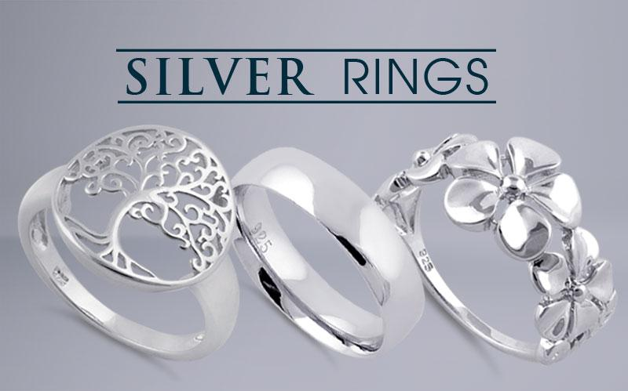
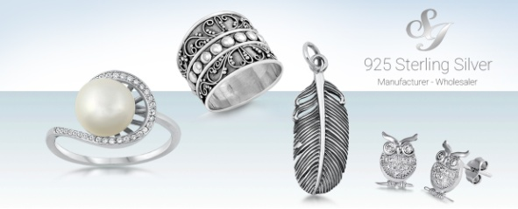
Silver
Silver has been known and used for thousands of years and it is considered as one of the three precious metals along with gold and platinum.
Pure silver is very soft metal with its lustrous white color.
Although it is harder than gold and much more plentiful, but still too soft in its natural state and required to be mixed with a harder metal for the use in jewelry manufacturing.
It ranks second in ductility and malleability to gold. It is normally stable in pure air and water but tarnishes when exposed to ozone, hydrogen sulfide or sulfur.
Asst.Prof :Mohamed el Awamy Mohamed (2020) Foreign language discussions (4)

Slide 9

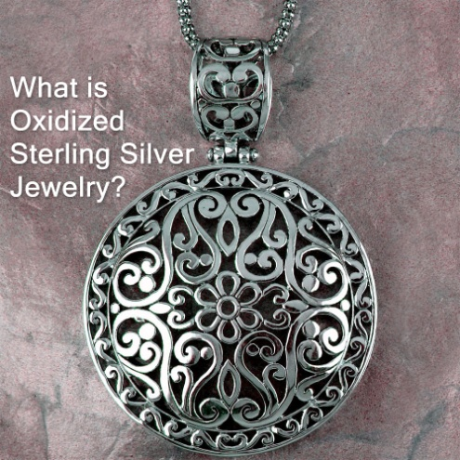
Silver is the brightest reflector of any metal (except for liquid mercury) and can be polished to a high sheen that even platinum can't achieve. It has also the highest electrical and thermal conductivity of all metals, even higher than copper.
Most silver is produced as a by-product of copper, gold, lead, and zinc mining. Commercial grade fine silver is at least 99.9% pure silver and purities greater than 99.999% are available. Mexico is the world's largest silver producer which contributed 15% of the annual production of the world. Canada, Peru, Australia and the United States are the other major countries, which are producing silver.
Asst.Prof :Mohamed el Awamy Mohamed (2020) Foreign language discussions (4)

Slide 10
It has long been valued as a precious metal and used in currency, jewelry, ornaments, and utensils. Now-a-days, silver is also used in photographic film, electrical contacts, mirrors, dentistry and surgical implants.
Silver Purity
Purity of silver is based on the other metals, which are available in the silver in the form of metal alloys. Unlike gold, but like platinum, silver purities are expressed as units of a 1,000 parts. On the basis of its purity, it can be described as below:
1- Pure / Fine Silver
It is the purest form of silver with 99.9% purity. It is also known as fine silver. In this form, silver is too soft to use for jewelry.
Purity - 999 points (99.9% pure silver)
Asst.Prof :Mohamed el Awamy Mohamed (2020) Foreign language discussions (4)

Slide 11
2-Sterling Silver
Due to the softness of pure / fine silver, it can not be used in its purest form for jewelry. Therefore, to give strength and durability to the pure silver, it is alloyed with other harder metals, usually copper. A mixture of 92.5% of pure silver and 7.5% of copper is known as Sterling Silver. St the most familiar and used form of silver alloys. Purity - 925 points (92.5% pure silver)
3-Coin Silver
A mixture of 90% pure silver and 10% metal alloy is known as Coin Silver. A process of melting down coins done in the 19th century, and mostly discarded today. Purity - 900 points (90.0% pure silver)
4-Mexican Silver
Sometimes silver from south of the border is designated ‘Mexican silver’, which consists anywhere from 90% to 99% pure silver.
Asst.Prof :Mohamed el Awamy Mohamed (2020) Foreign language discussions (4)

Slide 12
Silver Pricing
Silver is very much affordable metal and price of silver is very low as compared to other precious metals. Silver is currently about 1/50th the price of gold by mass. However, its low price allows freedom to silver craftsmen for experiment with new and innovative designs, which are later duplicated in more expensive gold and platinum, once the ‘style’ is safely established.
Asst.Prof :Mohamed el Awamy Mohamed (2020) Foreign language discussions (4)

Slide 13
والى لقاء آخر في المحاضرة القادمة ان شاء الله
والسلام عليكم ورحمة الله
مناقشات في التخصص باللغة الاجنبية( 4) (2020) أ.م.د/محمد العوامي محمد

