Slide 1


الدراسات العليا (تمهيدي ماجستير)
مناقشات في التخصص باللغة الاجنبية
المحاضرة الاولى
قسم النحت والتشكيل المعماري والترميم
أ.م.د/محمد العوامي محمد

Slide 2
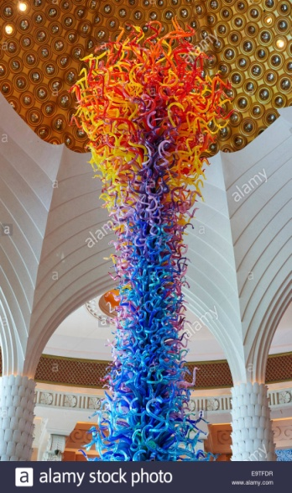
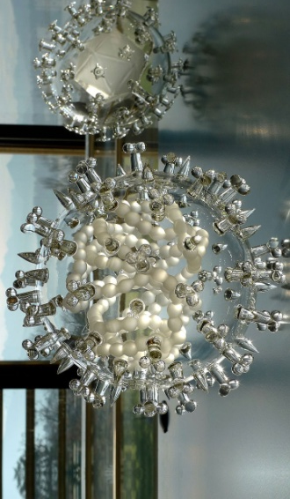
Introduction and definitions
The three dimensions that describe a solid object are height, width and depth.
Asst.Prof :Mohamed el Awamy Mohamed (2020) Foreign language discussions (1)

Slide 3
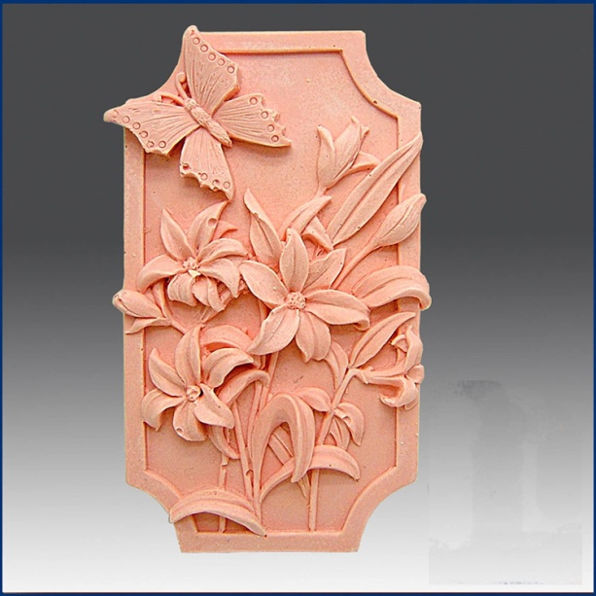
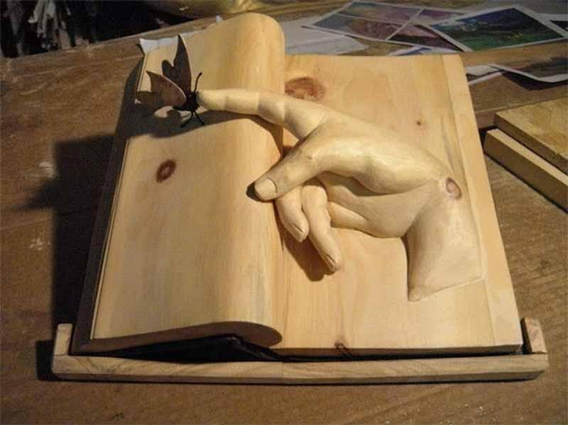
Sculpture is usually free-standing surrounded on all sides, (except under the base), by space. This is also known as sculpture "in the round" because it can be viewed from any angle
Asst.Prof :Mohamed el Awamy Mohamed (2020) Foreign language discussions (1)

Slide 4
Static and balanced or moving
Three dimensional objects need to be stable so as not to fall over.
Can an object remain balanced without depth? Sculptures that are designed to move or produce an illusion of movement are called ‘kinetic’.
A mobile is kinetic and consists of suspended shapes which move in response to air currents or their own structural tension.
Asst.Prof :Mohamed el Awamy Mohamed (2020) Foreign language discussions (1)

Slide 5
Sculpture in the past
Sculptural objects have been made by humans for thousands of years and have been used to represent, ancestors, places, mythological characters, memorials of people and to document historical events.
Sculptures have been endowed with spiritual powers, considered sacred and used in ceremonies, rituals and places of worship
Asst.Prof :Mohamed el Awamy Mohamed (2020) Foreign language discussions (1)

Slide 6
Sculpture can be architectural, symbols of cultural exchange, expressions of personal emotion, questions and reflections about how we understand and experience our world.
A wide variety of materials may be worked by removal such as carving, assembled by welding or modelling, or molded, or cast.
Asst.Prof :Mohamed el Awamy Mohamed (2020) Foreign language discussions (1)

Slide 7
Sculptures can be made out of anything. Traditional materials include stone, wood, clay and metal.
Some sculptures are painted or decorated with beads feathers or precious stones.
Twentieth century artists explored new materials and technologies, like plastics and fibre glass.
Some sculptors constructed works using found objects which they assembled to create a new object, similar to the technique of working with collage
Asst.Prof :Mohamed el Awamy Mohamed (2020) Foreign language discussions (1)

Slide 8
By mid twentieth century artists questioned established definitions of sculpture and explored new ways of working and creating.
Some worked directly with nature and the environment, using materials like salt, water and earth. Artists used light, sound or their own body to represent an idea sculpturally.
Asst.Prof :Mohamed el Awamy Mohamed (2020) Foreign language discussions (1)

Slide 9
Sculpture is the branch of the visual arts that operates in three dimensions. It is one of the plastic arts.
Durable sculptural processes originally used carving (the removal of material) and modelling (the addition of material, as clay), in stone, metal, ceramics, wood and other materials but, since Modernism, there has been an almost complete freedom of materials and process.
Asst.Prof :Mohamed el Awamy Mohamed (2020) Foreign language discussions (1)

Slide 10
Sculpture is an art form that has three dimensions: height, width, and depth. It is often meant to be viewed from all sides, and its meaning can be constructed and enhanced based on the perspective of the viewer.
Sculptures can be created from almost anything—traditional materials, such as stone, wood, clay, and metal; other materials, such as plastic and paper; and found and recycled objects. The materials an artist chooses to create sculpture can help communicate the meaning of the artwork.
Asst.Prof :Mohamed el Awamy Mohamed (2020) Foreign language discussions (1)

Slide 11
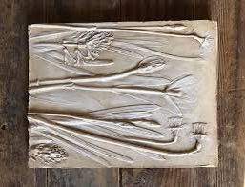
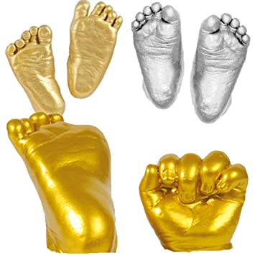
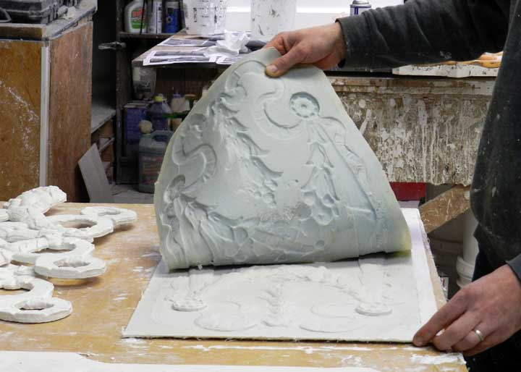
Sculpture the art of making two- or three-dimensional representative or abstract forms, esp. by carving stone or wood or by casting metal or plaster
Asst.Prof :Mohamed el Awamy Mohamed (2020) Foreign language discussions (1)

Slide 12
Sculpture in stone survives far better than works of art in perishable materials, and often represents the majority of the surviving works (other than pottery) from ancient cultures, though conversely traditions of sculpture in wood may have vanished almost entirely. However, most ancient sculpture was brightly painted, and this has been lost.
Asst.Prof :Mohamed el Awamy Mohamed (2020) Foreign language discussions (1)

Slide 13
MODELING a sculpture technique meaning to shape a pliable material.(clay)
ADDITION a sculptural technique meaning to build up, to assemble or to put on.
CASTING a sculptural technique in which liquid materials are shaped by pouring into a mold. To copy a solid object by pouring a liquid, such as melted metal, clay, wax, or plaster, into a mold and letting it harden. The mold is then removed and a copy, or cast, is left in the shape of the mold.
Asst.Prof :Mohamed el Awamy Mohamed (2020) Foreign language discussions (1)

Slide 14
SUBTRACTIVE A sculptural technique which material is carved or cut away. Carving is a
way of making sculpture by cutting away unwanted parts.
MOLD a negative (hollow) form that is filled with a material such as plaster or metal and removed when the material hardens into the shape of the mold. A mold can be used to make copies of an object.
CHISEL a sculptural tool used in the subtractive process. Chisels are used by sculptors for carving stone, wood, and other materials.
Asst.Prof :Mohamed el Awamy Mohamed (2020) Foreign language discussions (1)

Slide 15
والى لقاء آخر في المحاضرة القادمة ان شاء الله
والسلام عليكم ورحمة الله
مناقشات في التخصص باللغة الاجنبية( 1) (2020) أ.م.د/محمد العوامي محمد

